Slide 1
Computer Architecture
Atul Kahate

Slide 2
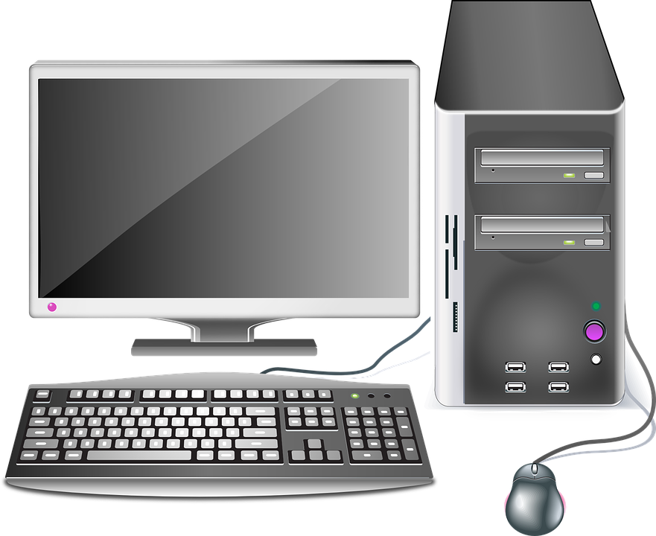
Computer Basics
Processing
Input
Output

Slide 3
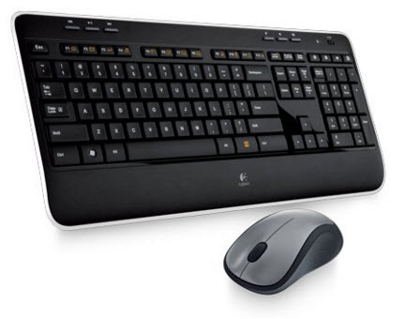
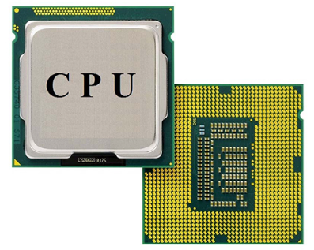
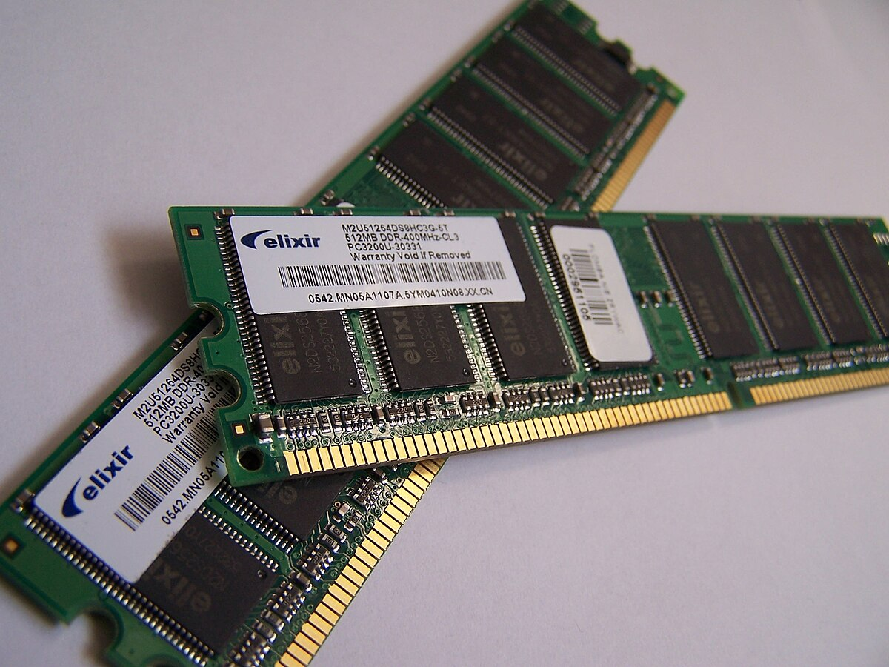
Main Components
Memory Subsystem
Input/Output Subsystem
Central Processing Unit

Slide 4
Program Execution
Disk
Main memory
CPU
Input
Program code after reading from the disk
Stored program
Execution
Operating System
Output

Slide 5
Computer Architecture
Structure of a computer
Instruction set of a computer
Designing a computer

Slide 6
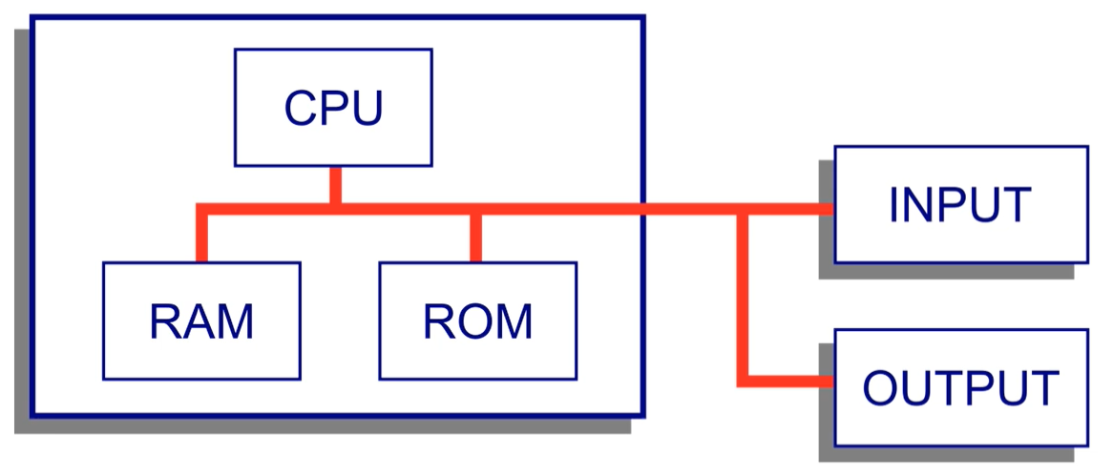
Structure of a Computer

Slide 7
Instruction Set
To get work done from a computer, we must speak its language
Instructions = Words of a computer’s language
Instruction set = Language of a computer
Different CPU family = Different instruction set
Examples: Intel, ARM, MIPS
Consists of 0s and 1s (hence binary)
Example: 0011 1110 0000 0101 (Machine language)
Meaning: Add a value 5 to a register
Difficult! Solution: Use English-equivalent (Assembly language), in this case ADI 5

Slide 8
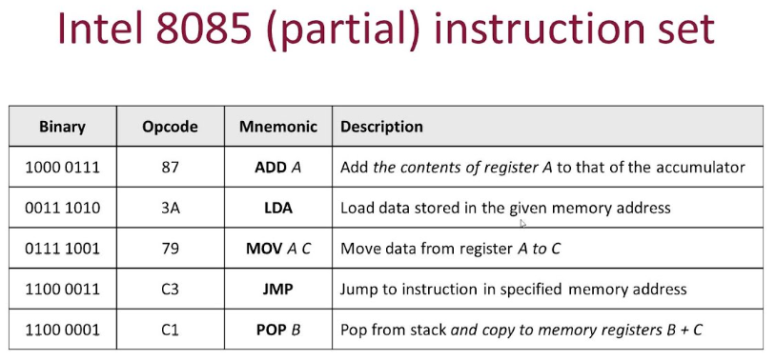
Sample Instruction Set

Slide 9
Designing a Computer
Performance requirements
Interconnections between various parts of a computer system
Defining the instructions set
Logical aspects of the implementation (e.g. CPU/memory design)

Slide 10
Computer Performance
For individual computers: Response time or Execution time = Time at the completion of a task – Time at the start of the task
At an overall level: Throughput or Bandwidth = Total amount of work done in a given time
Scenario 1: Replace a processor in a computer with a faster processor
Impact: Both response time and throughput will improve
Scenario 2: Add multiple processors so as to handle multiple tasks
Impact: In general, both response time and throughput will improve

Slide 11
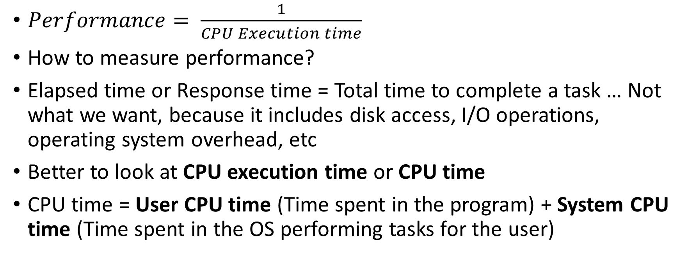
Computer Performance
$Performance= \frac{1}{CPU Execution time}$
How to measure performance?
Elapsed time or Response time = Total time to complete a task … Not what we want, because it includes disk access, I/O operations, operating system overhead, etc
Better to look at CPU execution time or CPU time
CPU time = User CPU time (Time spent in the program) + System CPU time (Time spent in the OS performing tasks for the user)

